Slide 1
HDAT 9700
Time series analysis
Online tutorial

Slide 2
Overview
Understanding time series and working with time series data in R
Statistical properties of time series data
Introduction to time series models (ARIMA)

Slide 3
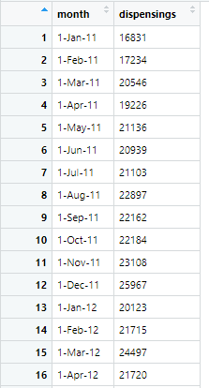
What are time series data?
Chronological sequence of measurements equally spaced through time—the order is important
One observation (per outcome) for every time point—often a summary statistic
The frequency is always the same (e.g. daily, weekly, monthly, etc)
**Important—observations made at neighbouring time points are often correlated and thus not independent

Slide 4
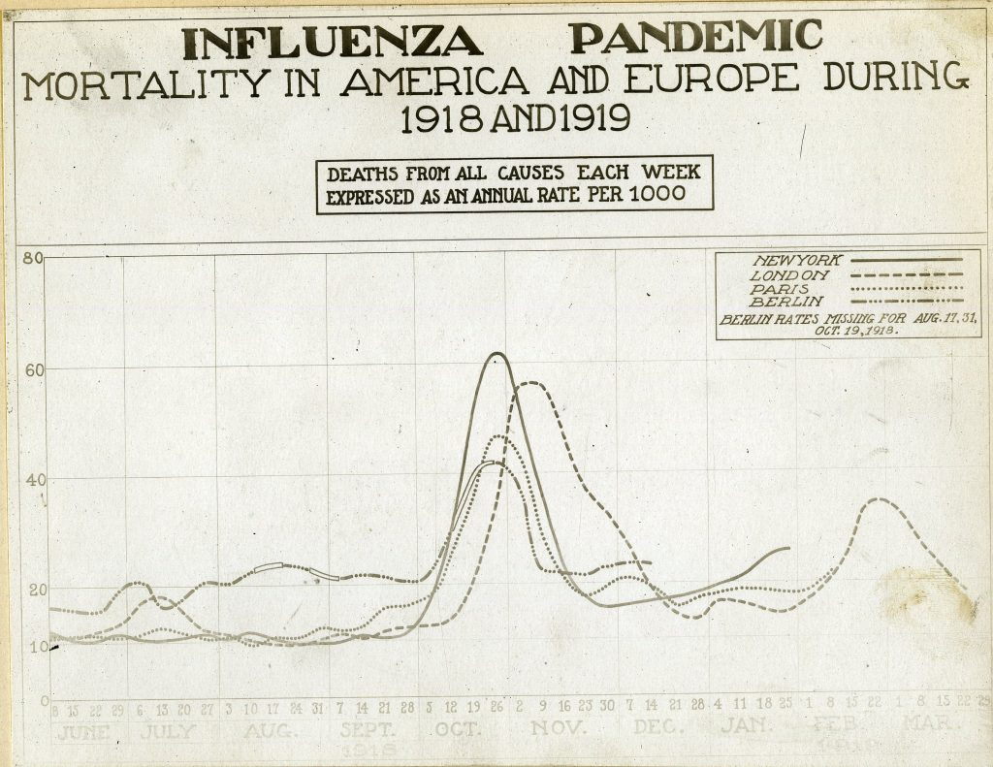


What are time series data?
Outcome = Deaths per 1000 population
Frequency = Week

Slide 5
Why are time series data useful?
Understand how health outcomes are changing over time;
Compare trends in different measures, or in different jurisdictions;
Compare current trends to historical trends;
Forecasting of future values;
Infectious disease surveillance;
To evaluate population-level health interventions (which we will cover in the next Chapter).

Slide 6

Time = Year
Outcome = Count of new HIV cases, deaths, and people living with HIV

Slide 7
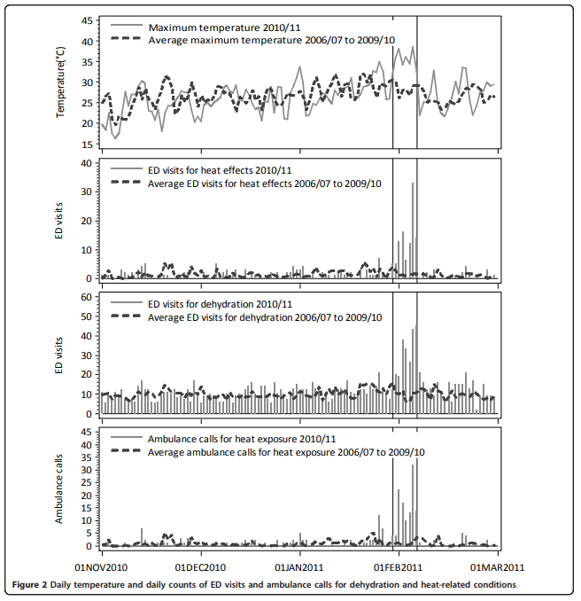
Time = Day
Outcome = Maximum and average daily temperature; count and average of ED visits and ambulance calls
Source: Schaffer et al. Environ Health. 2012;11:3.

Slide 8
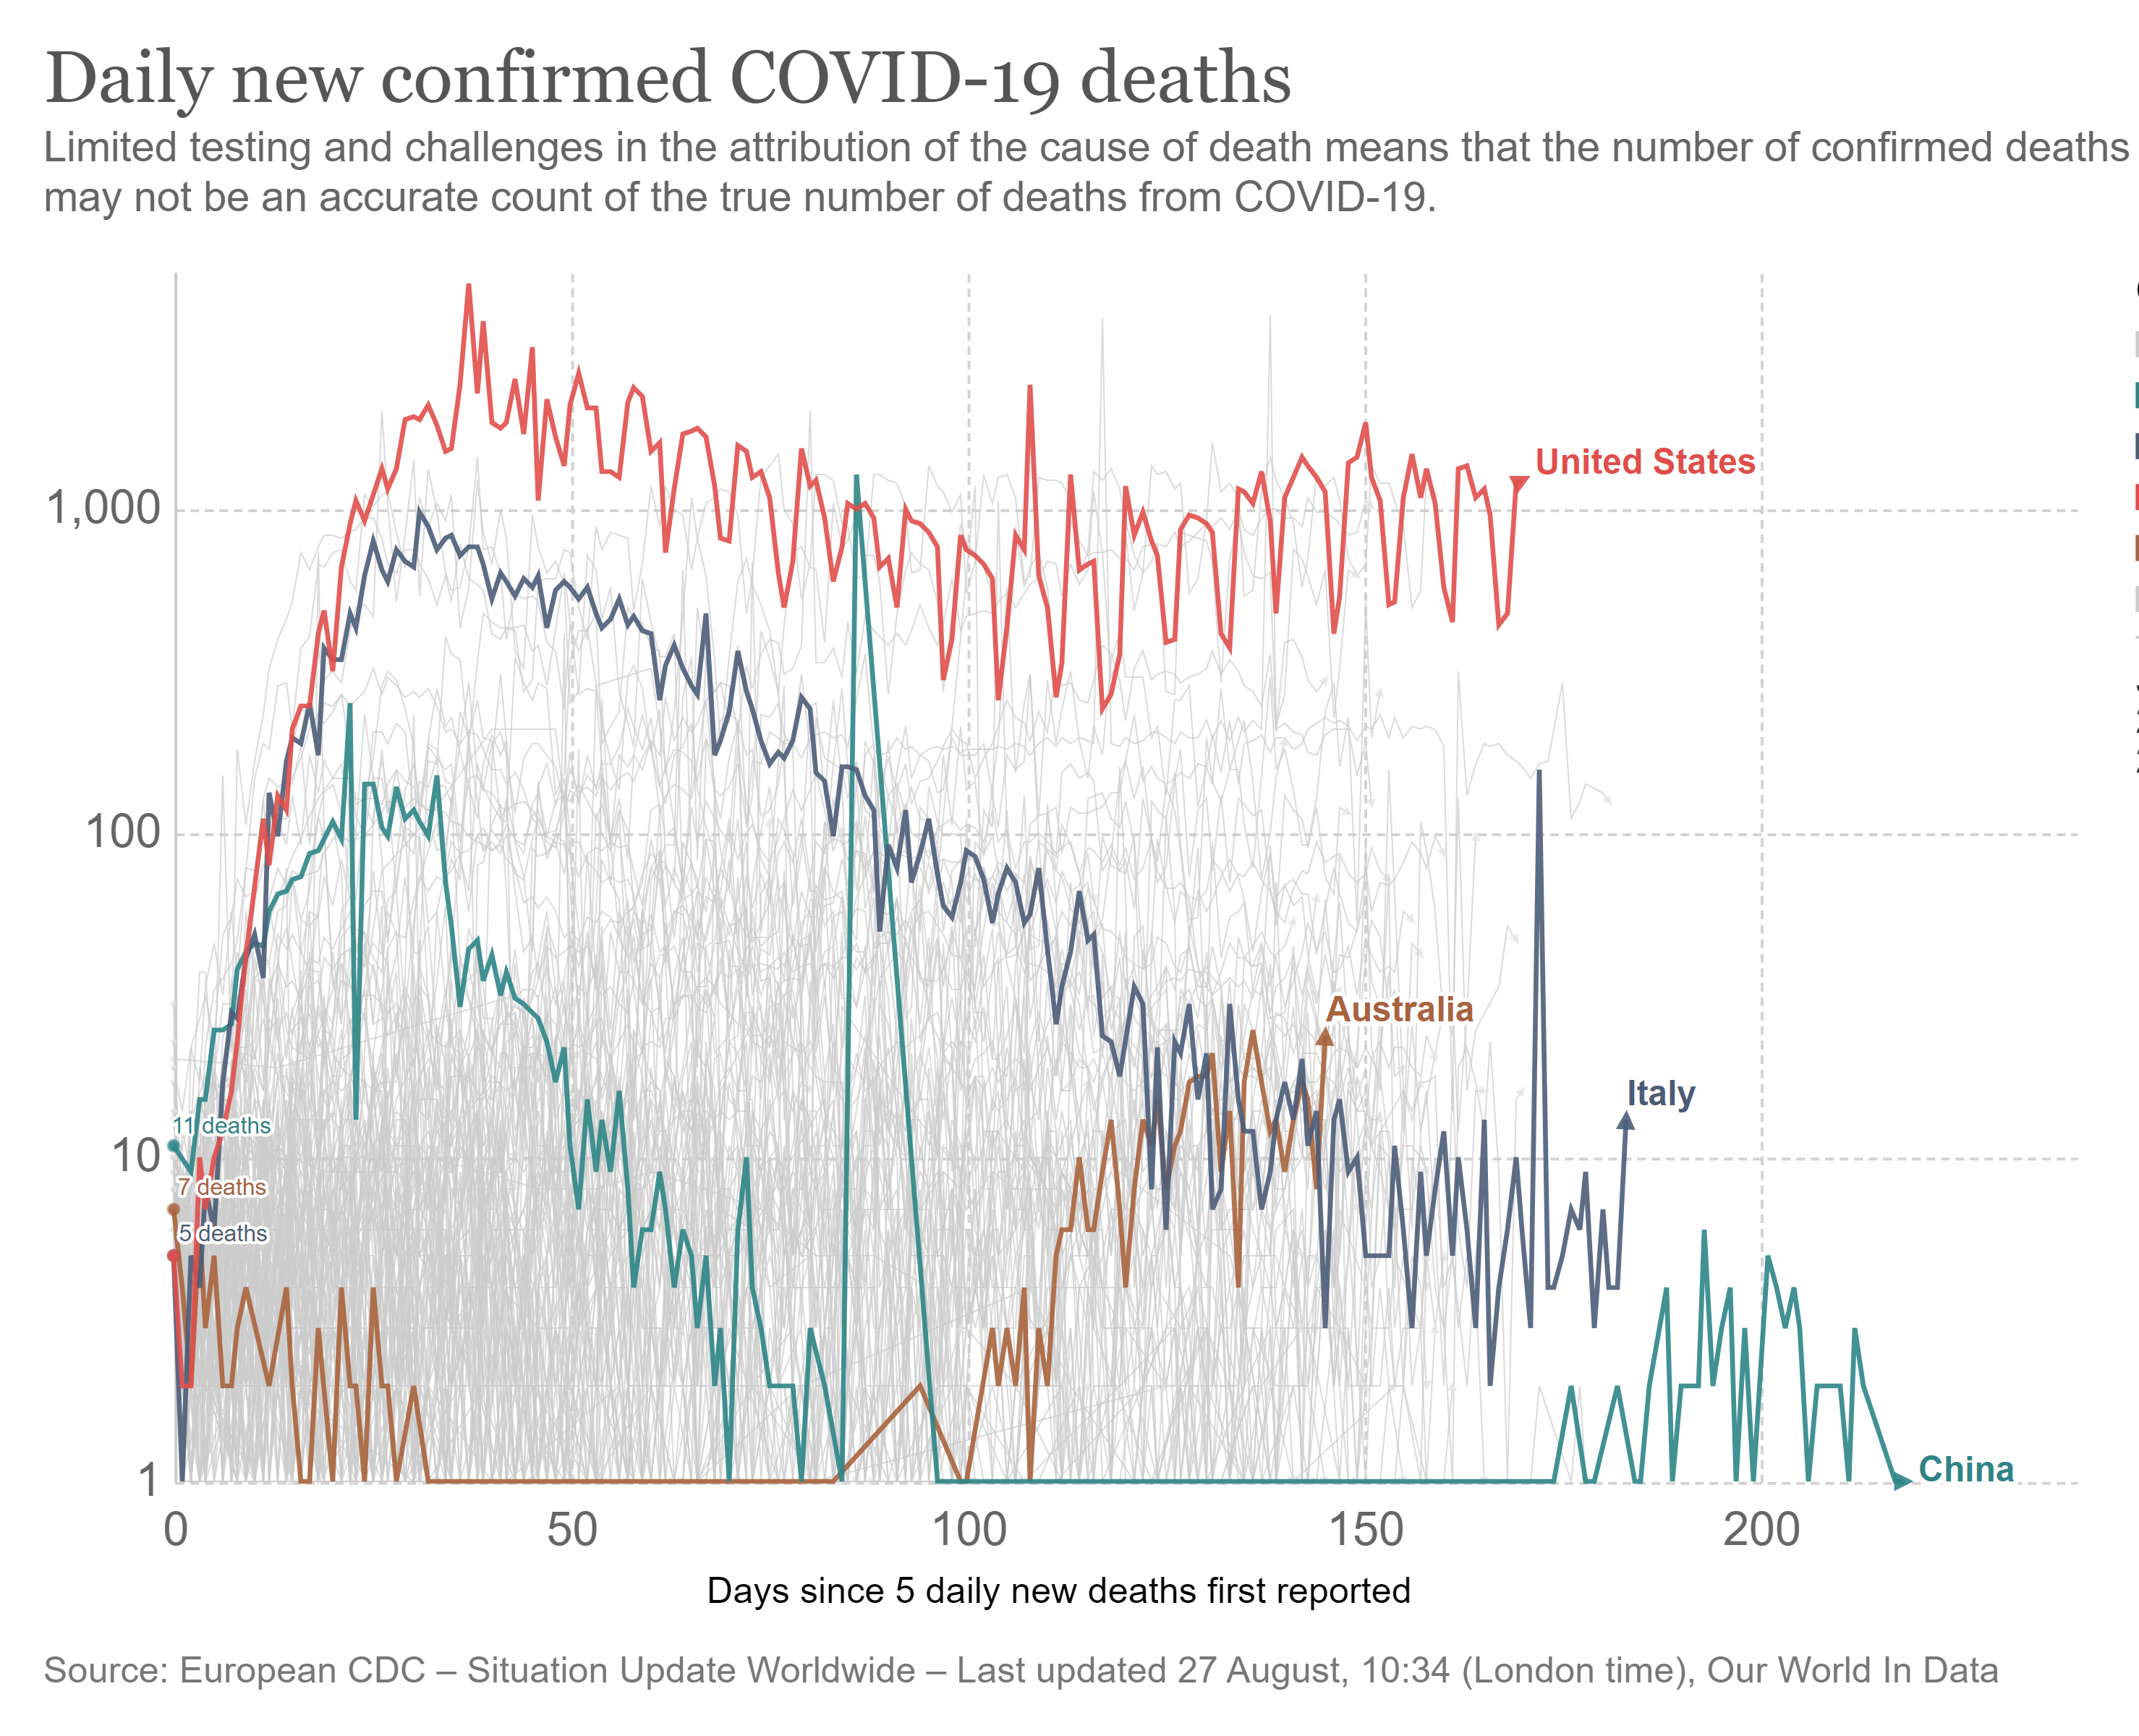
Time = No. days since 5 deaths
Outcome = Count of deaths

Slide 9
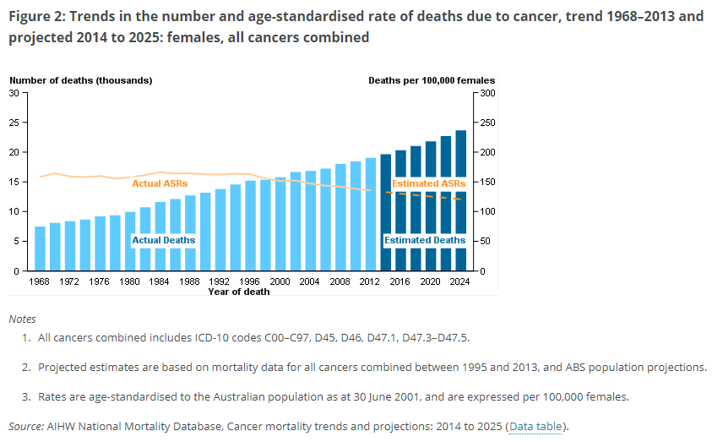
Time = Year
Outcome = Number and age-standardised rate of cancer deaths in females, observed and projected

Slide 10
Working with time series data in R – ts objects
data.ts <- ts(data, start=, end=, frequency=)
Examples – monthly data:
data.ts <- ts(data, start=c(2005,1), end=c(2009,12), frequency=12)
data.ts <- ts(data[,2], start=c(2005,1), end=c(2009,12), frequency=12)
Example – yearly data:
data.ts <- ts(data, start=2005, end=2009, frequency=1)
Example – quarterly data
data.ts <- ts(data, start=c(2005,1), end=c(2009,4), frequency=4)

Slide 11
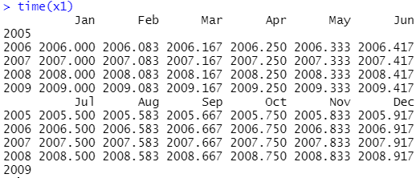
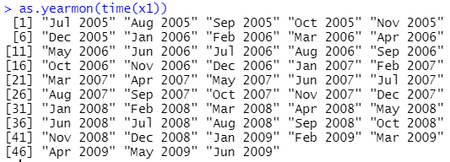
Working with time series data in R – ts objects
Time component is held in an “index”, that indicates the relative position of each observation in the ts object
To access the index use:
time(data.ts)
OR
as.yearmon(time(data.ts))

Slide 12
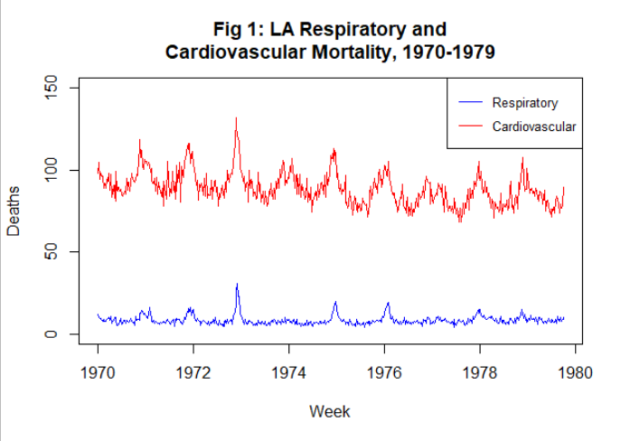
Visualisation
Always start by visualising your data!!

Slide 13
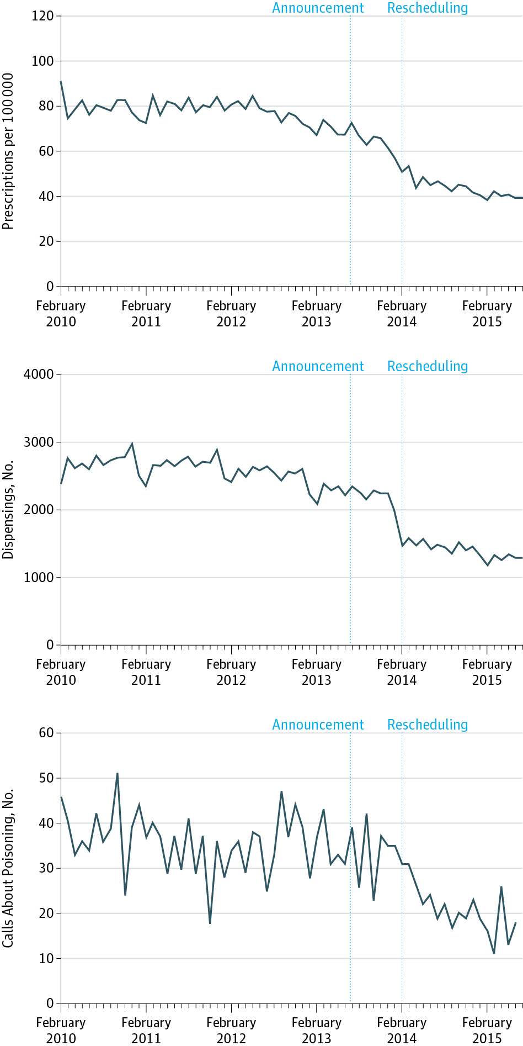
What makes a good figure?
Figure label
Clear indication of frequency
Population named
Figure 1. Monthly Time Series of Alprazolam Prescriptions per 100 000 Australian Population
Axis clearly labelled, units clear
y-axis range proportionate to data
Legend. The rescheduling was announced on June 28, 2013, whereas the rescheduling took effect on February 1, 2014.
Extra information in legend
Schaffer et al. 2016. JAMA Intern Med
Notes:
Ggplot vs base plot vs other

Slide 14
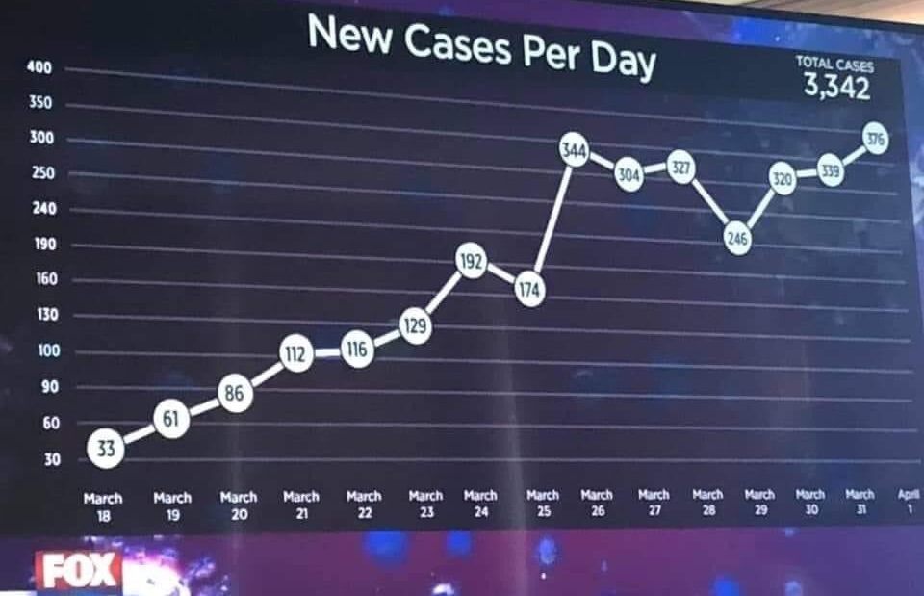
What makes a bad figure?
Notes:
COVID cases in 2020, FOX News Colorado? Bad = inconsistent y-axis

Slide 15
Time series decomposition
1
Trend
Seasonality
Error (random variation)
2
3

Slide 16
What is a trend?
Trend: a long-term increase or decrease in the data—it can be linear (best represented by a straight line), or non-linear (e.g. exponential). Some time series have no trend.

Slide 17
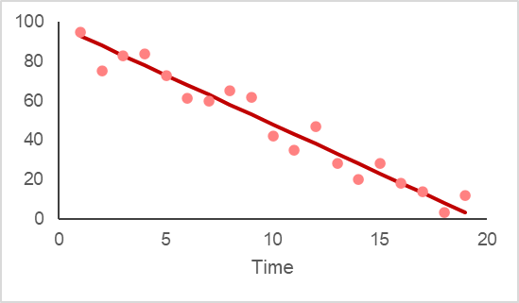
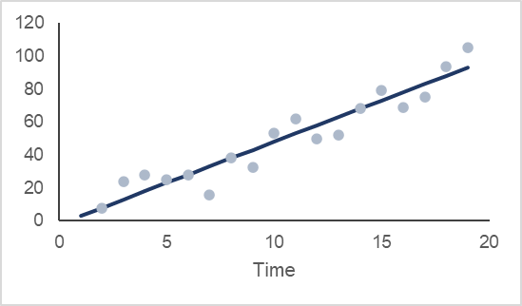
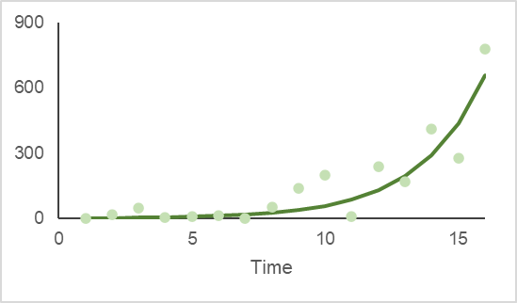
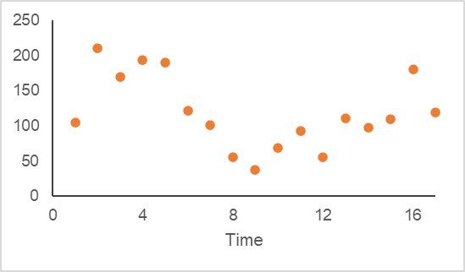
Downward linear trend
Upward linear trend
Exponential trend
???

Slide 18
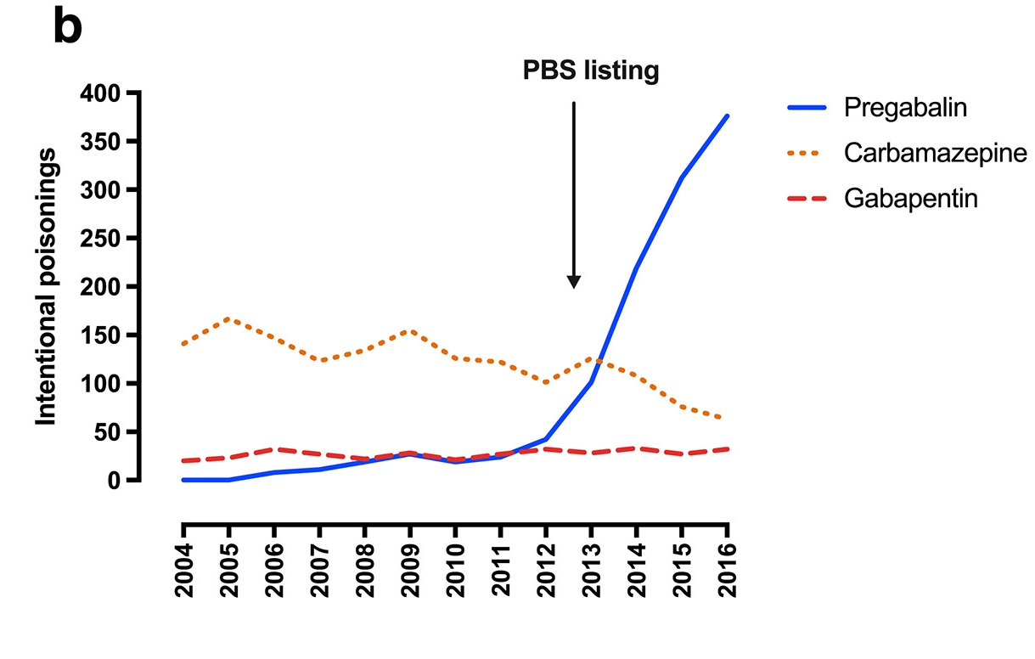
Figure 1 (b) intentional poisonings with pregabalin, gabapentin and carbamazepine reported to the NSWPIC, 2004–2016. Arrow shows PBS listing, 2013. PBS = Pharmaceutical Benefits Scheme; NSWPIC = New South Wales Poisons Information Centre.
Source: Cairns et al. Addiction. 2019;144:1026.

Slide 19
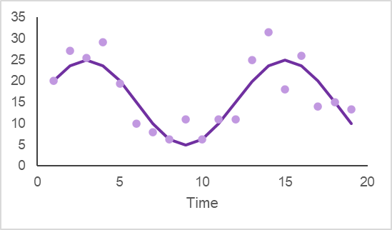
What is seasonality?
Seasonality: the outcome is correlated with calendar time, such as time of year or day of the week
It is always of a fixed frequency
It can be due to natural causes or business/administrative processes
Seasonality will depend on the time unit or frequency of your series (e.g. daily, weekly)
Yearly time series do not have seasonality! (at least not health data)

Slide 20
Example: Monthly sales of cold and flu products
When are sales highest? lowest?
Why?

Slide 21
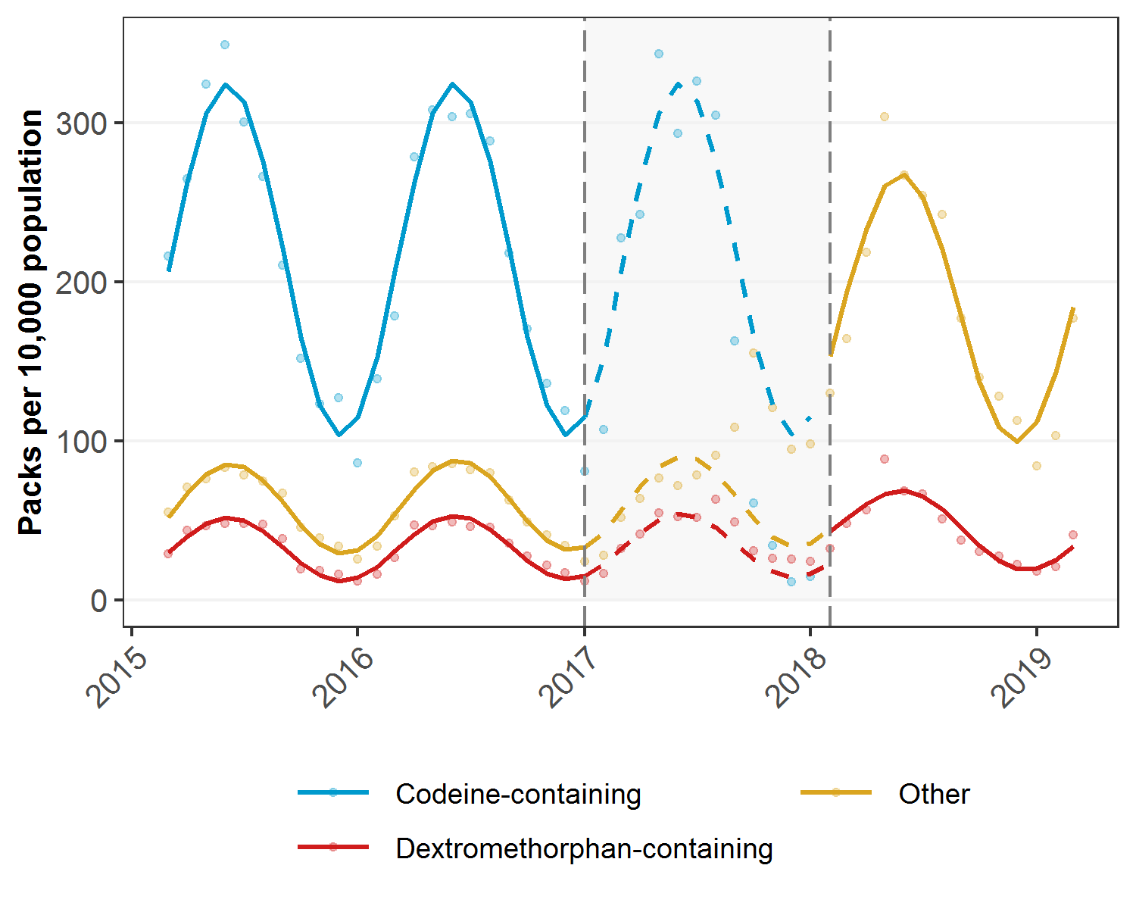
Example: Monthly sales of cold and flu products
When are sales highest? lowest?
Why?
Source: Schaffer et al. Med J Aust. 2020 Apr;212(7):321-327

Slide 22
What is error/random variation? What are outliers?
Error (aka random variation): it is the variation in the series not explained by trend or seasonality.
Outliers: extreme values in your series—they may occur randomly, or due to an underlying process.
How to deal with extreme values/outliers?? – it depends!

Slide 23
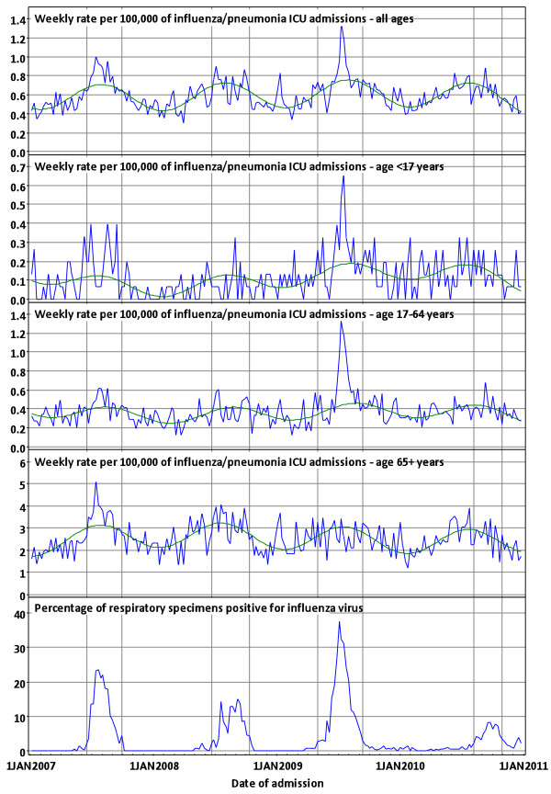
Example: ICU admissions for influenza/pneumonia
ICU admissions were very high in winter 2009, especially in people <65 years—this was due to influenza A(H1N1)pdm09 which was circulating that year
Source: Schaffer et al. BMC Public Health 2012 Oct 12;12:869.

Slide 24
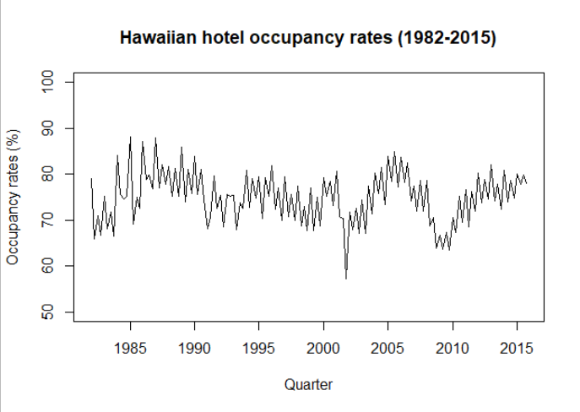
Example: Time series decomposition

Slide 25
Example: Time series decomposition

Slide 26
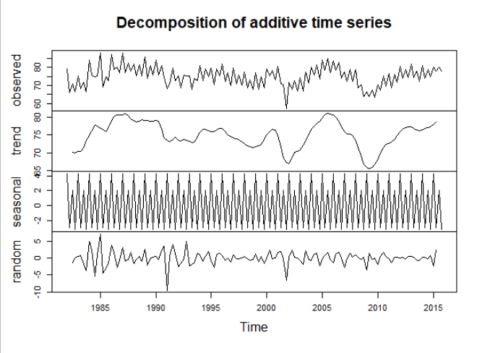
Example: Time series decomposition
decompose(data=, type=c(“additive”, “multiplicative”))
Decomposition plot of Hawaiian hotel occupancy data:
plot(decompose(hor))
Notes:
Downside – hard to see seasonal effects

Slide 27
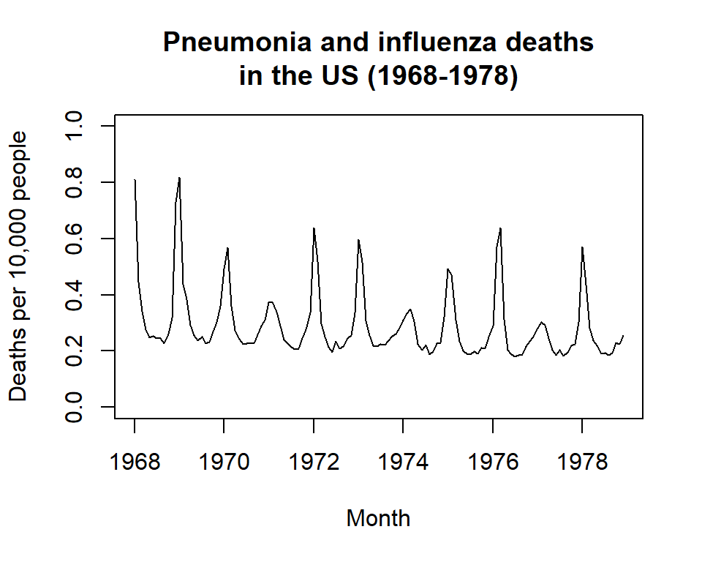
A better way to visualise seasonal effects
Seasonal plot of influenza mortality rate in the US:
ggseasonplot()

Slide 28
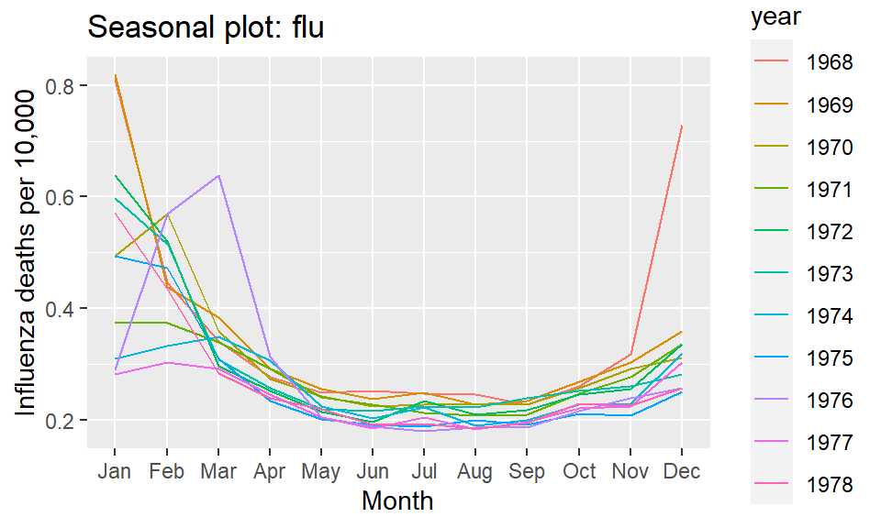
A better way to visualise seasonal effects
ggseasonplot(flu)
What does this plot tell you?

Slide 29


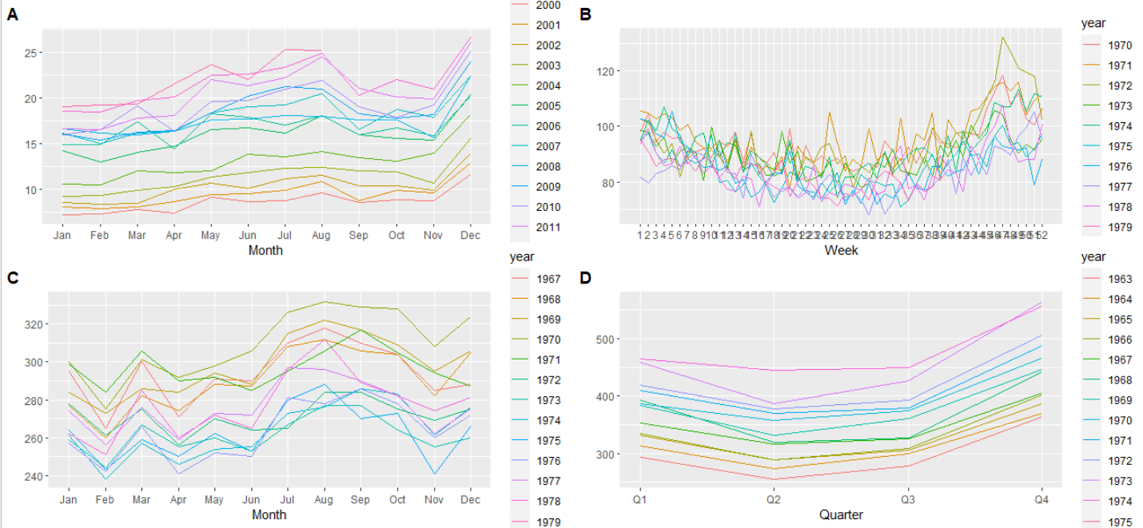


Which of the following is: 1. Births in the US? 2. Debit card spending in Iceland? 3. Cardiovascular mortality in LA? 4. Beer production in Australia?

Slide 30
What time/season-related factors exist for the following measures:
Dispensing of chronic medicines (e.g. statins, antihypertensives, diabetes medicines)?
Dispensing of antibiotics?
GP visits?
Emergency department visits?

Slide 31
Statistical properties of time series
1
Stationarity
Autocorrelation
Seasonality
2
3

Slide 32
What is stationarity?
In simple terms, a stationary series has no trend, and no autocorrelation—therefore, it has a constant mean and constant variance.
This means it is easier to predict!

Slide 33
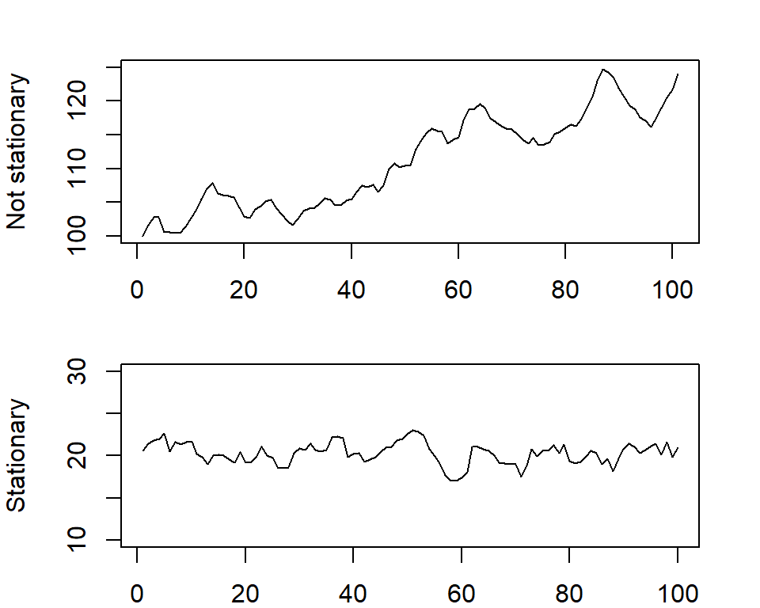
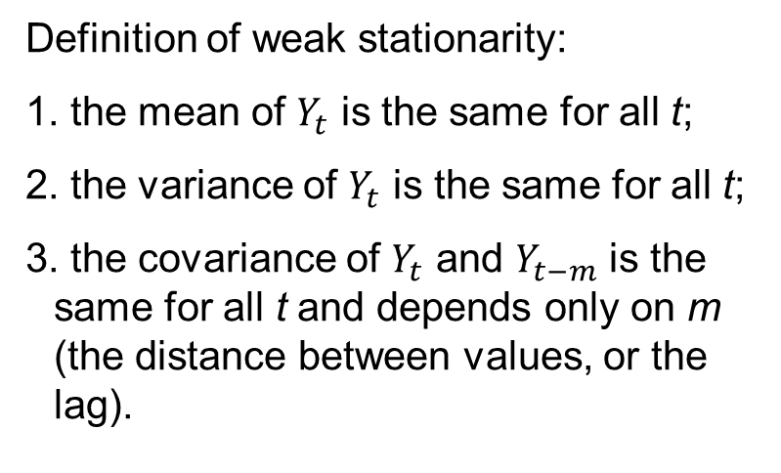
Stationarity
Definition of weak stationarity:
1. the mean of $Y_{t}$ is the same for all t;
2. the variance of $Y_{t}$ is the same for all t;
3. the covariance of $Y_{t}$ and $Y_{t−m}$ is the same for all t and depends only on m (the distance between values, or the lag).

Slide 34
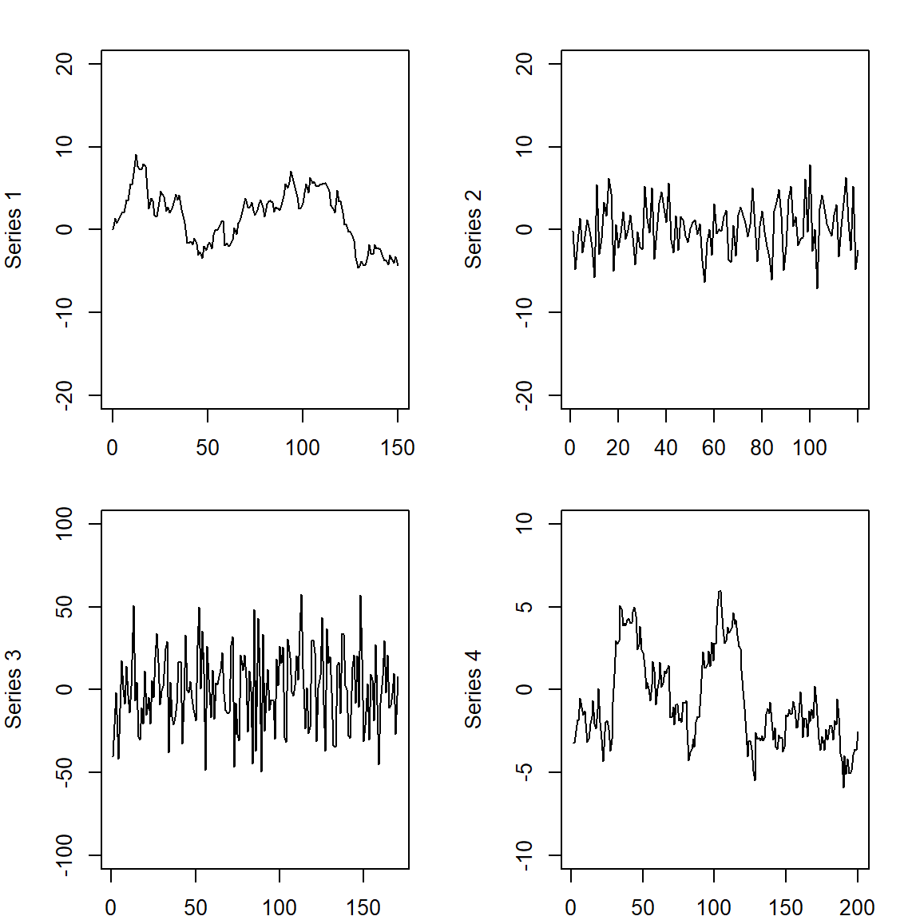
Which of these series appear stationary?

Slide 35


Which of these series appear stationary?

Slide 36
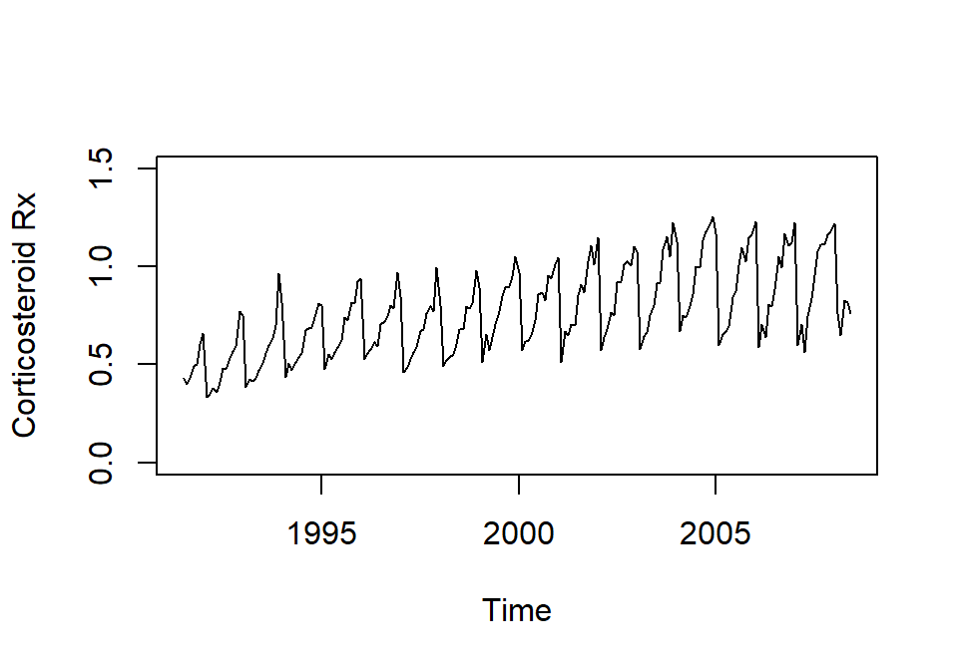
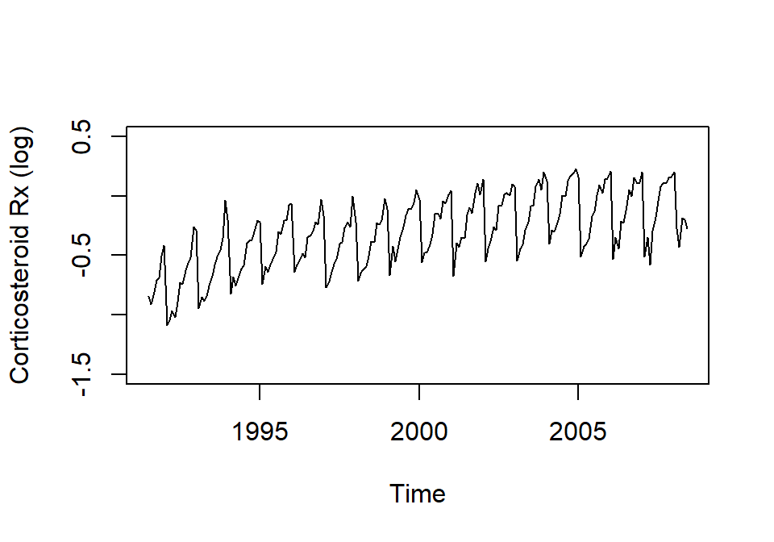
How to deal with non-stationarity
First: does your series have constant variance? → If not, try a log (natural) transformation
plot(h02)
plot(log(h02))

Slide 37
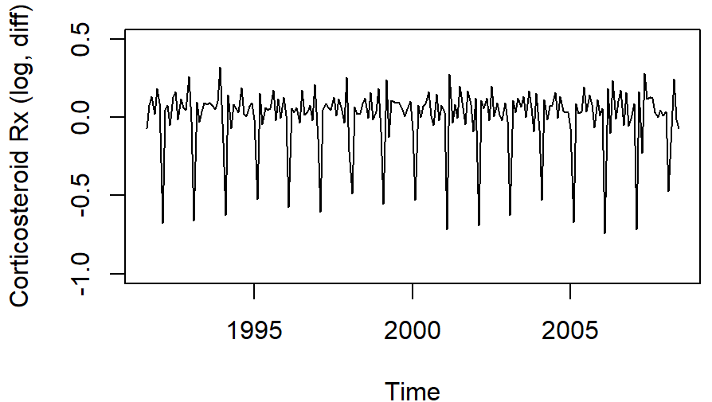
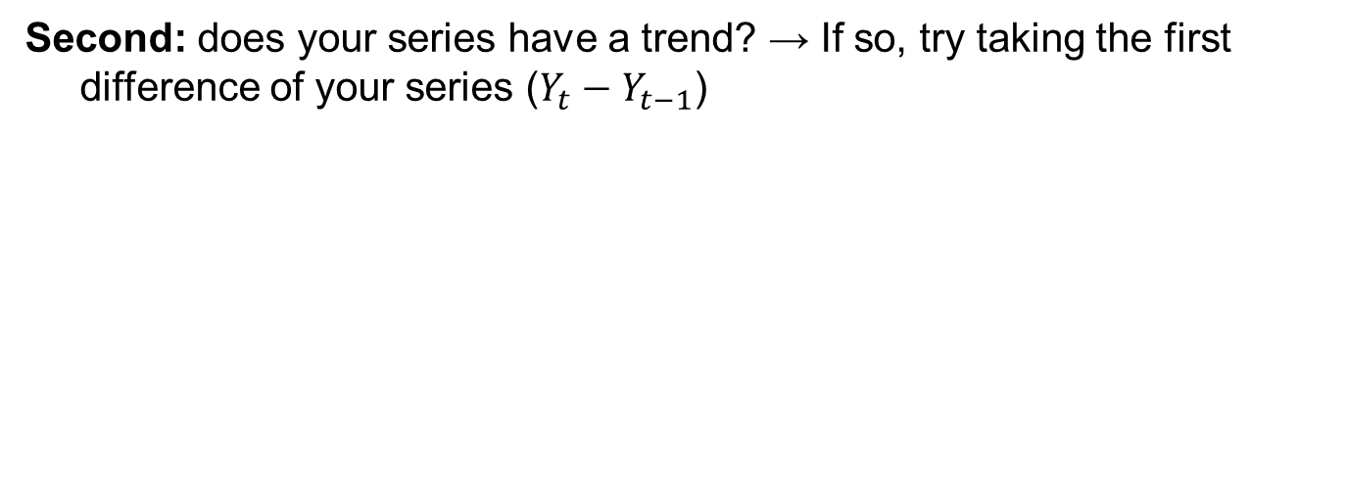
How to deal with non-stationarity
Second: does your series have a trend? → If so, try taking the first difference of your series ($Y_{t}−Y_{t−1}$)
plot(log(h02))
plot(diff(log(h02)))
***If needed, always log transform your data before taking the difference!!

Slide 38
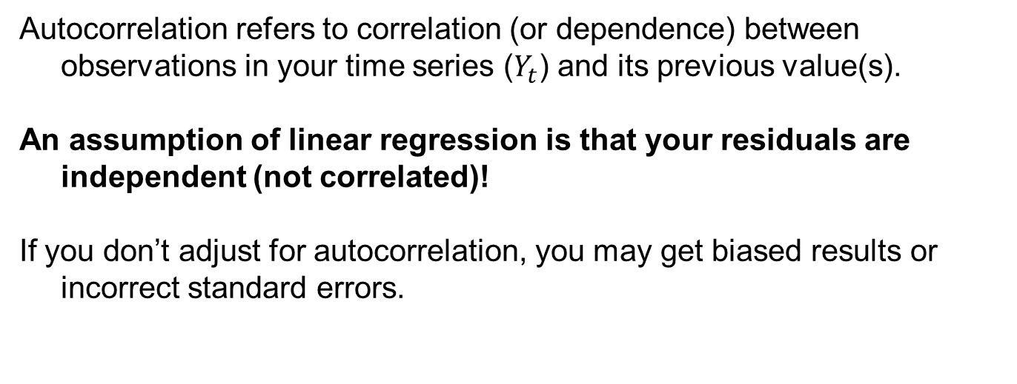
What is autocorrelation?
Autocorrelation refers to correlation (or dependence) between observations in your time series ($Y_{t}$) and its previous value(s).
An assumption of linear regression is that your residuals are independent (not correlated)!
If you don’t adjust for autocorrelation, you may get biased results or incorrect standard errors.

Slide 39
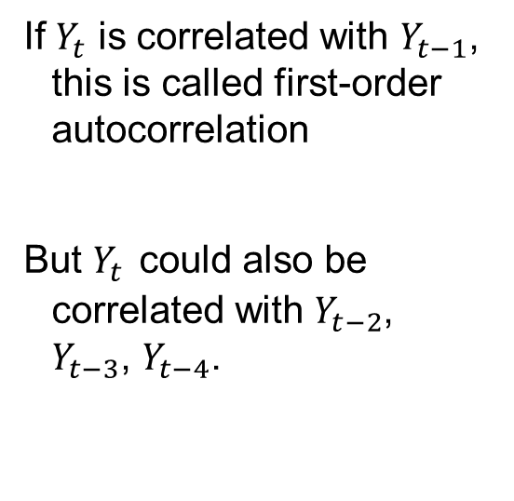
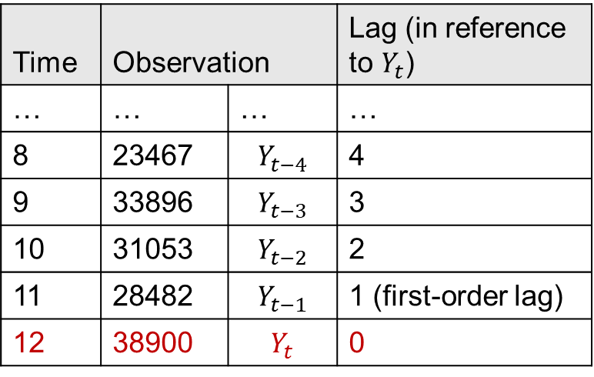
What do we mean when we talk about lag??
Time | Observation |  | Lag (in reference to $Y_{t}$)
… | … | … | …
8 | 23467 | $$Y_{t−4}$$ | 4
9 | 33896 | $$Y_{t−3}$$ | 3
10 | 31053 | $$Y_{t−2}$$ | 2
11 | 28482 | $$Y_{t−1}$$ | 1 (first-order lag)
12 | 38900 | $$Y_{t}$$ | 0
If $Y_{t}$ is correlated with $Y_{t−1}$, this is called first-order autocorrelation
But $Y_{t}$ could also be correlated with $Y_{t−2}$, $Y_{t−3}$, $Y_{t−4}$.

Slide 40
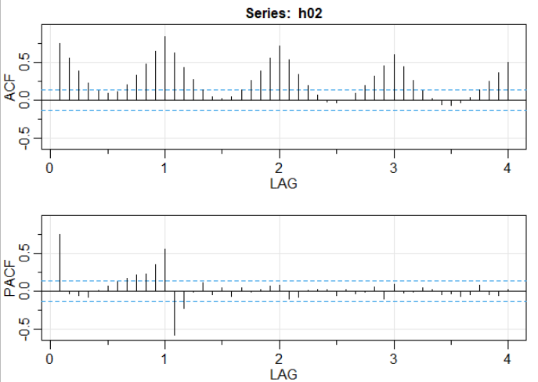
Autocorrelation function (ACF) and partial ACF plots
acf2(data=, lag=)
ACF/PACF plots for corticosteroid prescriptions
acf2(h02)
Notes:
Note: difference between acf and acf2!!

Slide 41
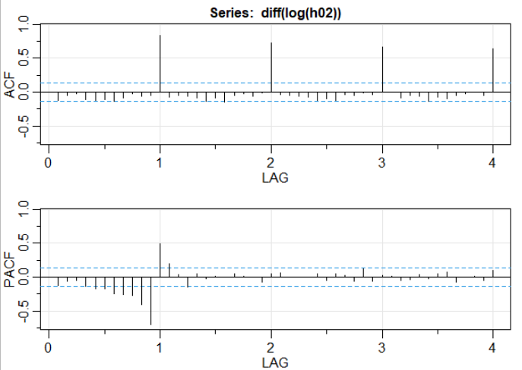
Autocorrelation function (ACF) and partial ACF plots
You should always check the ACF/PACF on your stationary series!
acf2(diff(log(h02)))

Slide 42
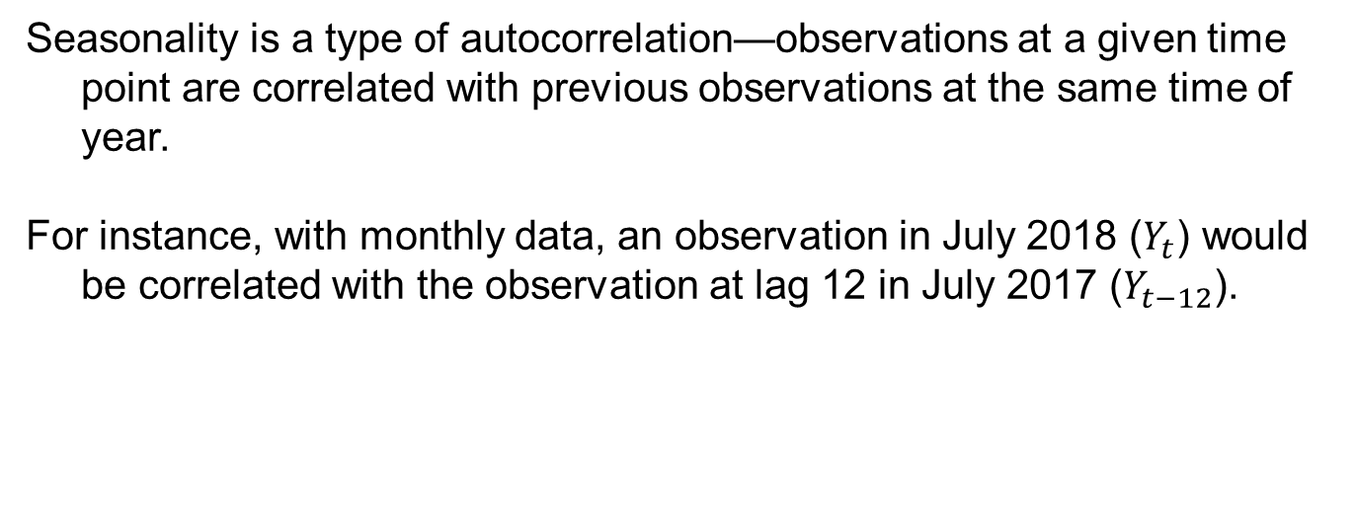
What is seasonality?
Seasonality is a type of autocorrelation—observations at a given time point are correlated with previous observations at the same time of year.
For instance, with monthly data, an observation in July 2018 ($Y_{t}$) would be correlated with the observation at lag 12 in July 2017 ($Y_{t−12}$).

Slide 43
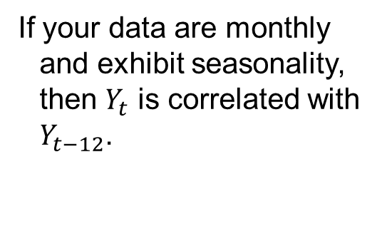
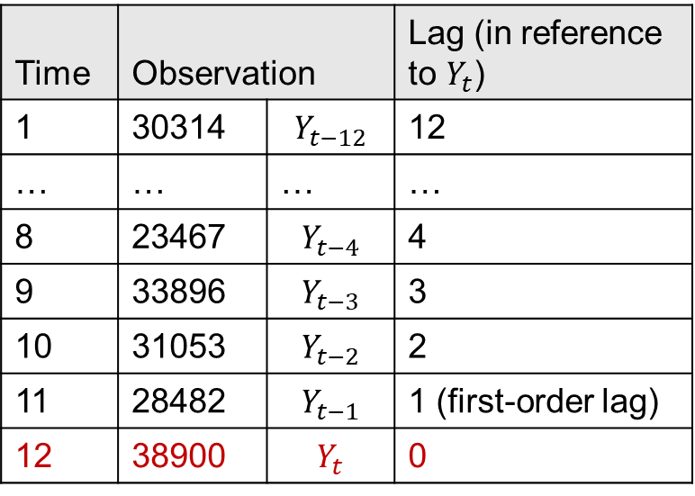
Seasonal autocorrelation
Time | Observation |  | Lag (in reference to $Y_{t}$)
1 | 30314 | $$Y_{t−12}$$ | 12
… | … | … | …
8 | 23467 | $$Y_{t−4}$$ | 4
9 | 33896 | $$Y_{t−3}$$ | 3
10 | 31053 | $$Y_{t−2}$$ | 2
11 | 28482 | $$Y_{t−1}$$ | 1 (first-order lag)
12 | 38900 | $$Y_{t}$$ | 0
If your data are monthly and exhibit seasonality, then $Y_{t}$ is correlated with $Y_{t−12}$.

Slide 44
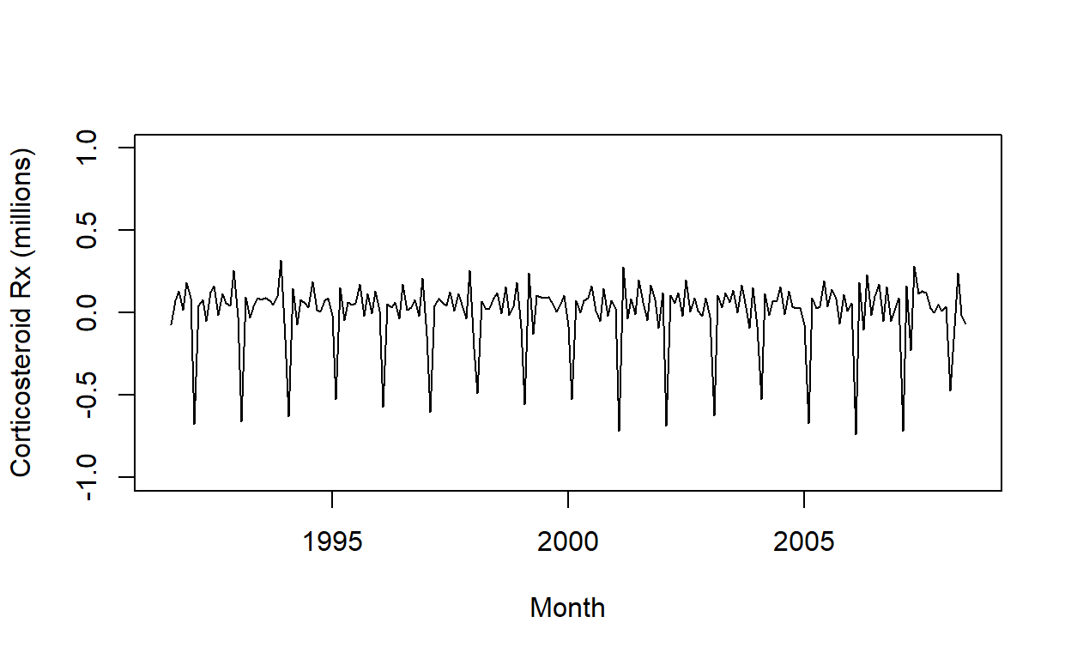
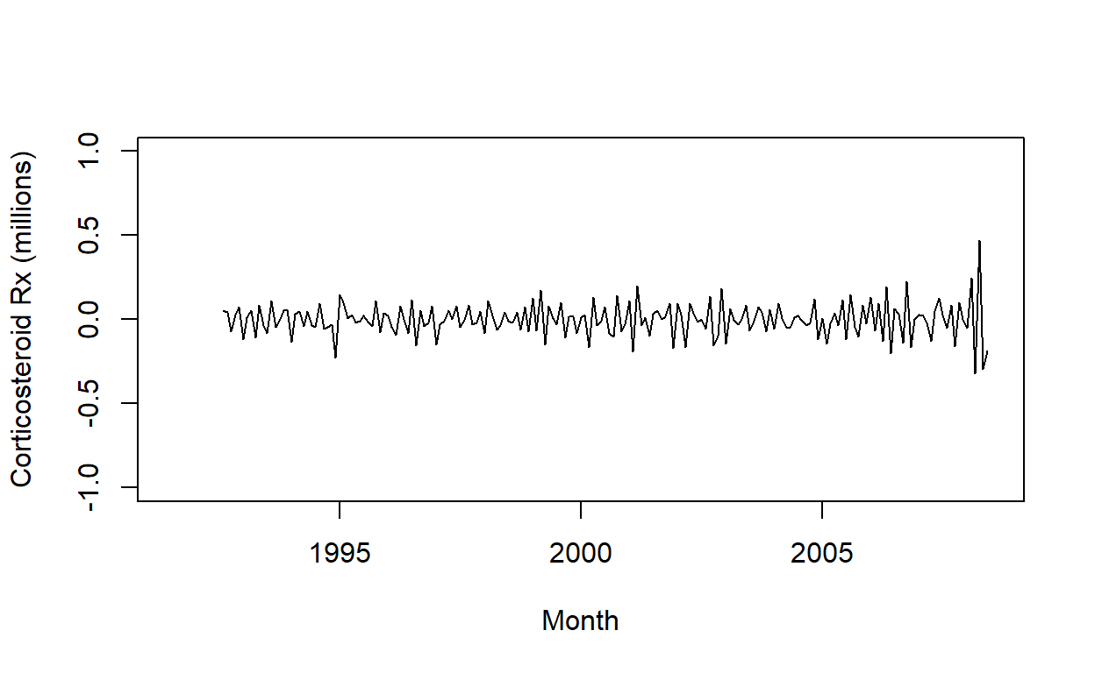
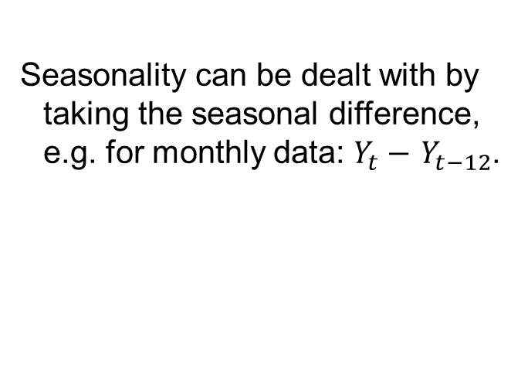
Seasonality
plot(diff(log(h02)))
Seasonality can be dealt with by taking the seasonal difference, e.g. for monthly data: $Y_{t}−$ $Y_{t−12}$.
plot(diff(diff(log(h02)),lag=12)
Your series is now stationary!

Slide 45
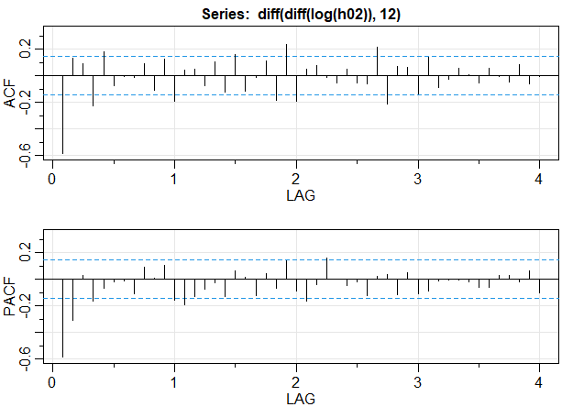
Seasonality
acf2(diff(diff(log(h02)),lag=12)

Slide 46
Time series models
Depending on your data, you may be able to use ordinary regression models to analyse your time series—we will cover this next Chapter.
An alternative is Autoregressive Integrated Moving Average (ARIMA) models, which can control for non-stationarity, autocorrelation and seasonality.

Slide 47
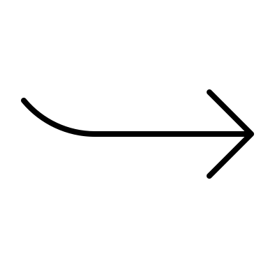
What is an ARIMA model?
ARIMA
Autoregressive
Moving average
Integration (differencing)

Slide 48
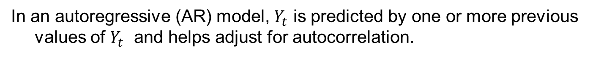
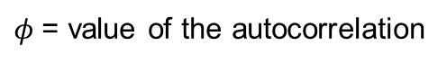
Autoregressive component
In an autoregressive (AR) model, $Y_{t}$ is predicted by one or more previous values of $Y_{t}$ and helps adjust for autocorrelation.
p = order of the AR model
$$Y_{t}=c+φ_{1}Y_{t−1}+φ_{2}Y_{t−2}+…+φ_{p}Y_{t−p}+ε_{t}$$
$φ$= value of the autocorrelation

Slide 49
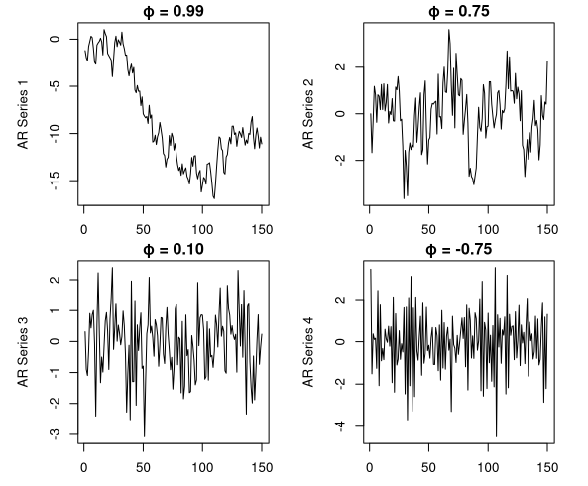
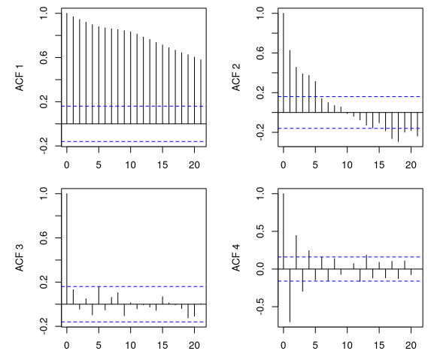
Autoregressive component

Slide 50
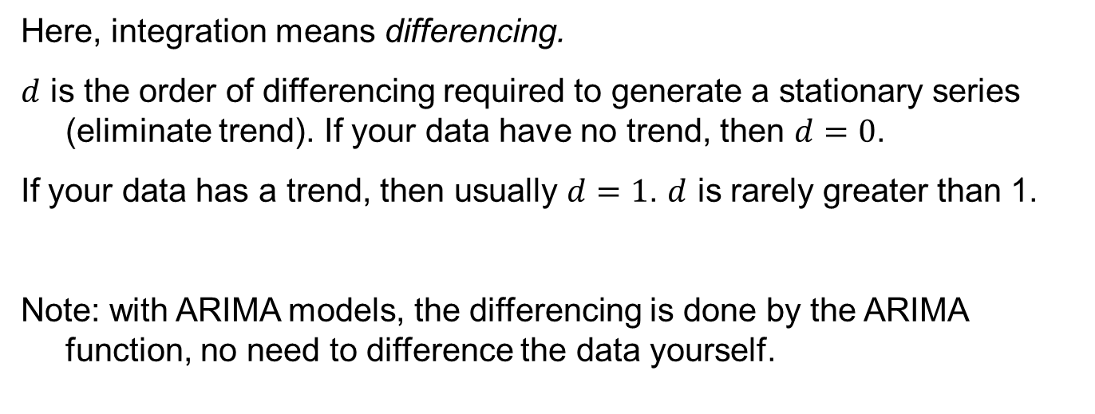
Integration component
Here, integration means differencing.
$d$ is the order of differencing required to generate a stationary series (eliminate trend). If your data have no trend, then $d=0$.
If your data has a trend, then usually $d=1$. $d$ is rarely greater than 1.
Note: with ARIMA models, the differencing is done by the ARIMA function, no need to difference the data yourself.

Slide 51
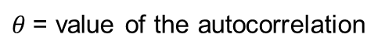
Moving average component
In a moving average (MA) model, $Y_{t}$ is predicted by one or more previous values of the error/residuals $ε_{t}.$
q = order of the MA model
$$Y_{t}=c+ε_{t}+θ_{1}ε_{t−1}+θ_{2}ε_{t−2}+…+θ_{q}ε_{t−q}$$
$θ$= value of the autocorrelation

Slide 52
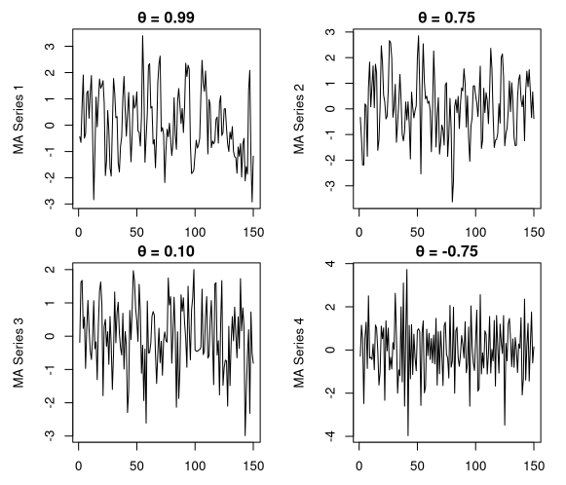

Moving average component

Slide 53



Seasonal component
In a seasonal model (sometimes called SARIMA), $Y_{t}$ is predicted by one or more previous values of $Y_{t−s}$ at a regular interval ($s$, the season). Seasonality is dealt with through differencing, not inclusion of seasonal dummy variables in the model.
s = season
$$Y_{t}=c+ФY_{t−s}$$
$Ф$ = value of the autocorrelation

Slide 54

ARIMA notation
$$ARIMA\left(p,d,q\right)$$
$p$ = the order of the AR part of the model;
$d$ = the differencing needed to eliminate trend (almost always 0 or 1);
$q$ = the order of the MA part of the model;
$p, d, q$, are all integers, and can also be zero.

Slide 55

ARIMA notation
A seasonal ARIMA model is indicated by:
$$ARIMA(p,d,q)×(P,D,Q)$$
Where $P$ and $Q$ are the autoregressive and moving average orders for the seasonal component, and $D$ is the degree of seasonal differencing (almost always 0 or 1).
If $d=1$and your data are seasonal, then $D$ will almost always be 1 as well.

Slide 56

Fitting an ARIMA model
The best approach is to specify d and D, and let an automated algorithm select the best terms for p and q (and P and Q if data are seasonal), like auto.arima in the forecast package.
Always check that your final model has a good fit!

Slide 57

auto.arima syntax
auto.arima(y=, d=, D=, xreg=, seasonal=c(TRUE,FALSE), stepwise=c(TRUE,FALSE))
For a seasonal time series that is non-stationary, typically specify:
auto.arima(data.ts, d=1, D=1, seasonal=TRUE, stepwise=FALSE)
xreg= is for inclusion of covariates, which we will see next Chapter.

Slide 58

Checking model fit
sarima(data=, p=, d=, q=, P=, D=, Q=, S=, xreg=)
You can rerun your select model in sarima (in the astsa package), which automatically generates residuals plots, and tests for autocorrelation
sarima(data.ts, p=2, d=0, q=0)

Slide 59


Should be stationary (constant mean and variance)
No residual autocorrelation (bars below blue line)
Normally distributed residuals (dots follow straight line)
No residual autocorrelation (dots above blue line)

Slide 60
What next?
Typically the model estimates for the values of the autocorrelation (AR) and/or moving average (MA) components are not of interest.
Once the best model is chosen, this can then be used as a base to add predictors using xreg= (to be covered in Chapter 5), or for forecasting.

Slide 61
Final words
Before embarking on any analysis of time series data, make sure you understand the patterns in your data, as well as the processes that have created it.
Aside from statistical issues, it is also important to understand how data were generated and recorded. Has this changed over time? What is captured/not captured?
While this Chapter has introduced you to several concepts related to time series data and analysis, in the next Chapter we will put this into practice.

